Slide 1
LL(1) Parser
A JavaScript Implementation by
Sabarinaath S S (RA2011026010115)
Anup Kewat (RA2011026010107)

Slide 2
Syntax Analysis
When an input string (source code or a program in some language) is given to a compiler, the compiler processes it in several phases, starting from lexical analysis (scans the input and divides it into tokens) to target code generation.
Syntax Analysis or Parsing is the second phase, i.e. after lexical analysis. It checks the syntactical structure of the given input, i.e. whether the given input is in the correct syntax (of the language in which the input has been written) or not.

Slide 3
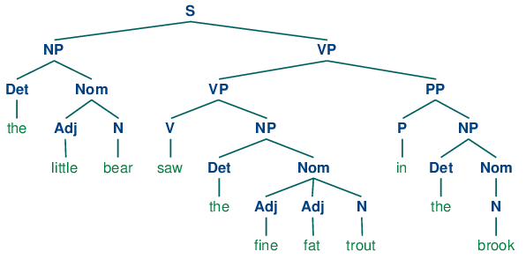
Syntax Tree
It does so by building a data structure, called a Parse tree or Syntax tree. The parse tree is constructed by using the pre-defined Grammar of the language and the input string. If the given input string can be produced with the help of the syntax tree (in the derivation process), the input string is found to be in the correct syntax. if not, the error is reported by the syntax analyzer.

Slide 4
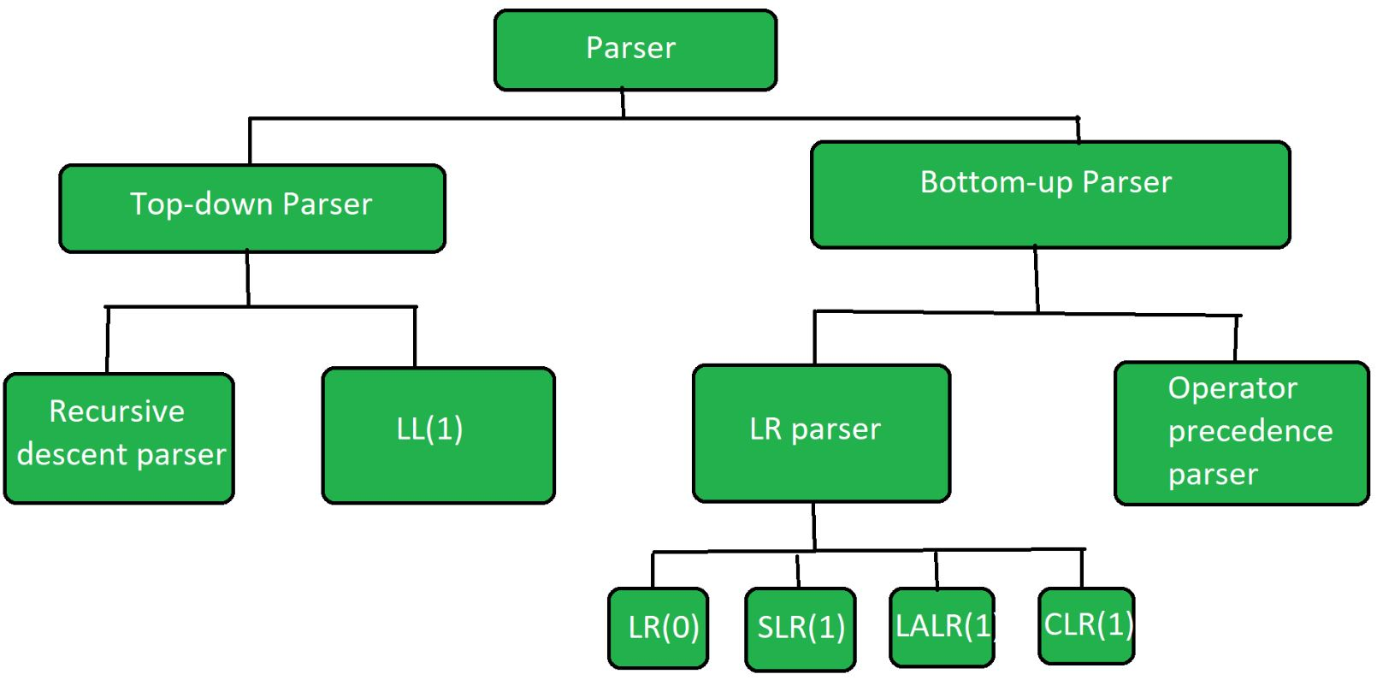
Types of Parsing

Slide 5
LL(1) parsing is a top-down parsing method in the syntax analysis phase of compiler design. Required components for LL(1) parsing are input string, a stack, parsing table for given grammar, and parser. Here, we discuss a parser that determines that given string can be generated from a given grammar(or parsing table) or not.

Slide 6
Implementation
We have used Vanilla JavaScript, HTML along with CSS styling for the implementation
getstartsymbol: returns the start symbol of the grammar.
getnonterminals: returns a list of all non-terminals in the grammar.
getinitfirstsets: returns a map of all non-terminals with empty sets as their first sets.
getinitfollowsets: returns a map of all non-terminals with 'eof' as the follow set of the start symbol and empty sets as the follow set of all other non-terminals.
computefirstset: computes the first set of a given rhs symbol or sequence of symbols.
recursefirstsets: recursively computes the first sets of all non-terminals in the grammar.
mapclone: creates a deep clone of a map object.
getfirstsets: computes the first sets of all non-terminals in the grammar.
updatefollowset: computes the follow set of a given non-terminal.
recursefollowsets: recursively computes the follow sets of all non-terminals in the grammar.
getfollowsets: computes the follow sets of all non-terminals in the grammar.
derive: recursively applies the productions of the grammar to the input string until it either derives the input string or determines that it cannot.
tryderive: uses the above functions to attempt to derive an input string from the grammar.

Slide 7
Implementation - Visualization
In the code, the parse tree was visualized using the Treant.js library, which is a JavaScript library for creating interactive tree diagrams.
To visualize the parse tree, the deriveTree function returns the parse tree in a JSON format that is compatible with the data structure used by Treant.js.
The JSON data structure has a text property that holds the label of the node, and a children property that holds an array of child nodes.
Once the JSON data structure is constructed, it is passed as the nodeStructure property to the Treant constructor. The Treant constructor takes an object that defines the properties of the tree diagram, such as the container element, the node spacing, and the orientation of the tree.

Slide 8
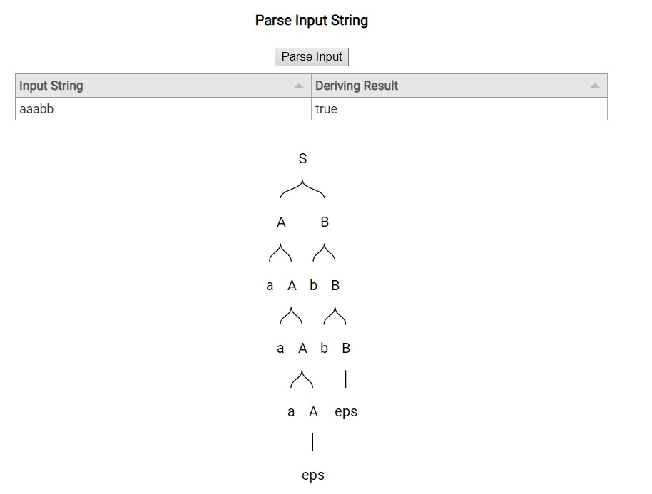
Outputs

Slide 9
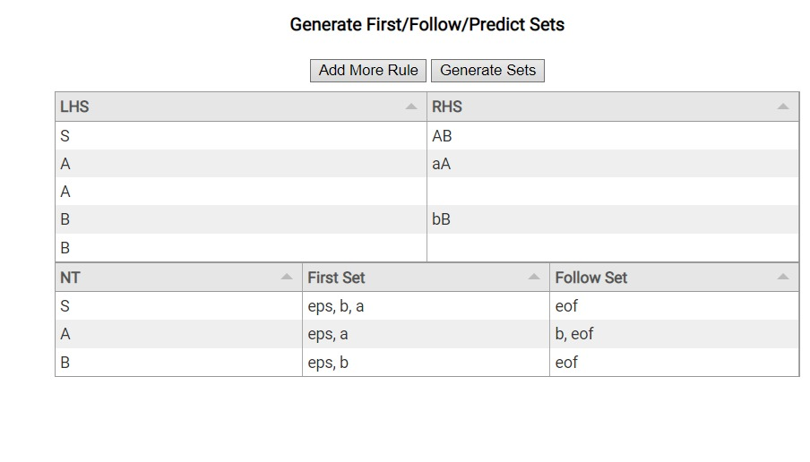
Outputs

